Slide 1
Robustness Comparison of State-of-the-Art Face Recognition Models
FaceNet vs. ArcFace vs. AdaFace on LFW with Robustness Evaluation
Camila Lightfoot, CS 480 Fall 2025

Slide 2
Topic Significance – Robust Facial Recognition
Increasingly used for authentication, surveillance, etc.
Photo robustness matters due to real-world image degredation
Comparing the three most impactful face-embedding models under identical testing conditions demonstrates their validity

Slide 3
Problem Statement
Evaluate three moden face-embedding models
Benchmark using LFW [4], a standard verification dataset for facial recognition models, to develop a baseline for each model
Test each model under different, controlled degredations
Compare and contrast each model using the test results

Slide 4
Models Evaluated
FaceNet [1]:triplet-loss embeddings, L2-normalized feature space
ArcFace [2]: additive angular margin loss for discriminative embeddings
AdaFace [3]: quality-adaptive margins (face quality-aware training)

Slide 5
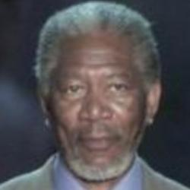
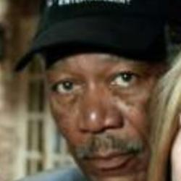
“Labeled Faces in the Wild” Dataset
13,000+ face images of famous people
Pair classification (same vs different person) verification protocol
Preprocessing: deep funneled LFW, MTCNN alignment, 160×160 (FaceNet/ArcFace) and 112×112 (AdaFace)

Slide 6
Methodology
Image pair → Detector/Aligner (MTCNN) → Model → Embeddings → Cosine Similarity → ROC/EER
All models evaluated using identical preprocessing
All embeddings were L2-normalized
ROC AUC and EER were the metrics being analyzed

Slide 7



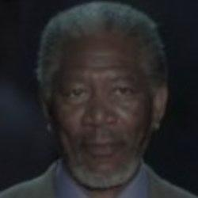
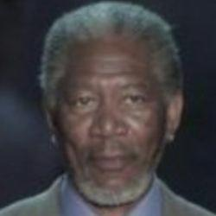
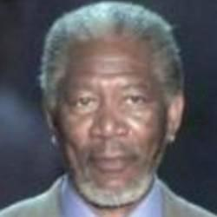
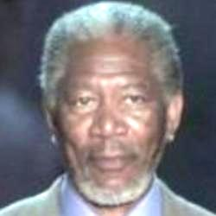
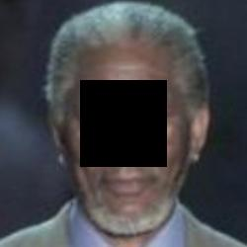
Robustness Tests
We tested the following (robust_tmp dir):
  Gaussian blur (r = 1, 2, 3)
  Lighting shifts (0.5, 0.8, 1.2, 1.5 scaling)
Normal face
Central occlusion

Slide 8
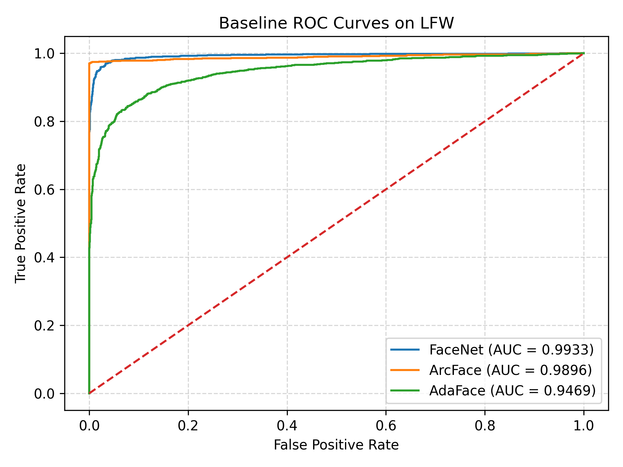
Baseline Results (ROC Curves)
FaceNet AUC ≈ 0.993
ArcFace AUC ≈ 0.990
AdaFace AUC ≈ 0.947

Slide 9
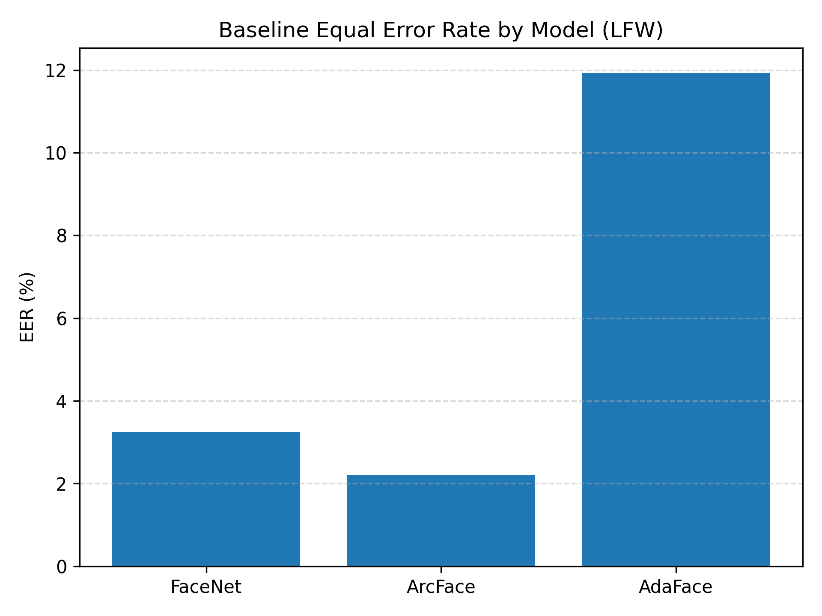
Baseline Results EER Table
Model | ROC AUC | EER (%)
FaceNet | 0.993 | 3.25%
ArcFace | 0.990 | 2.20%
AdaFace | 0.947 | 11.94%

Slide 10
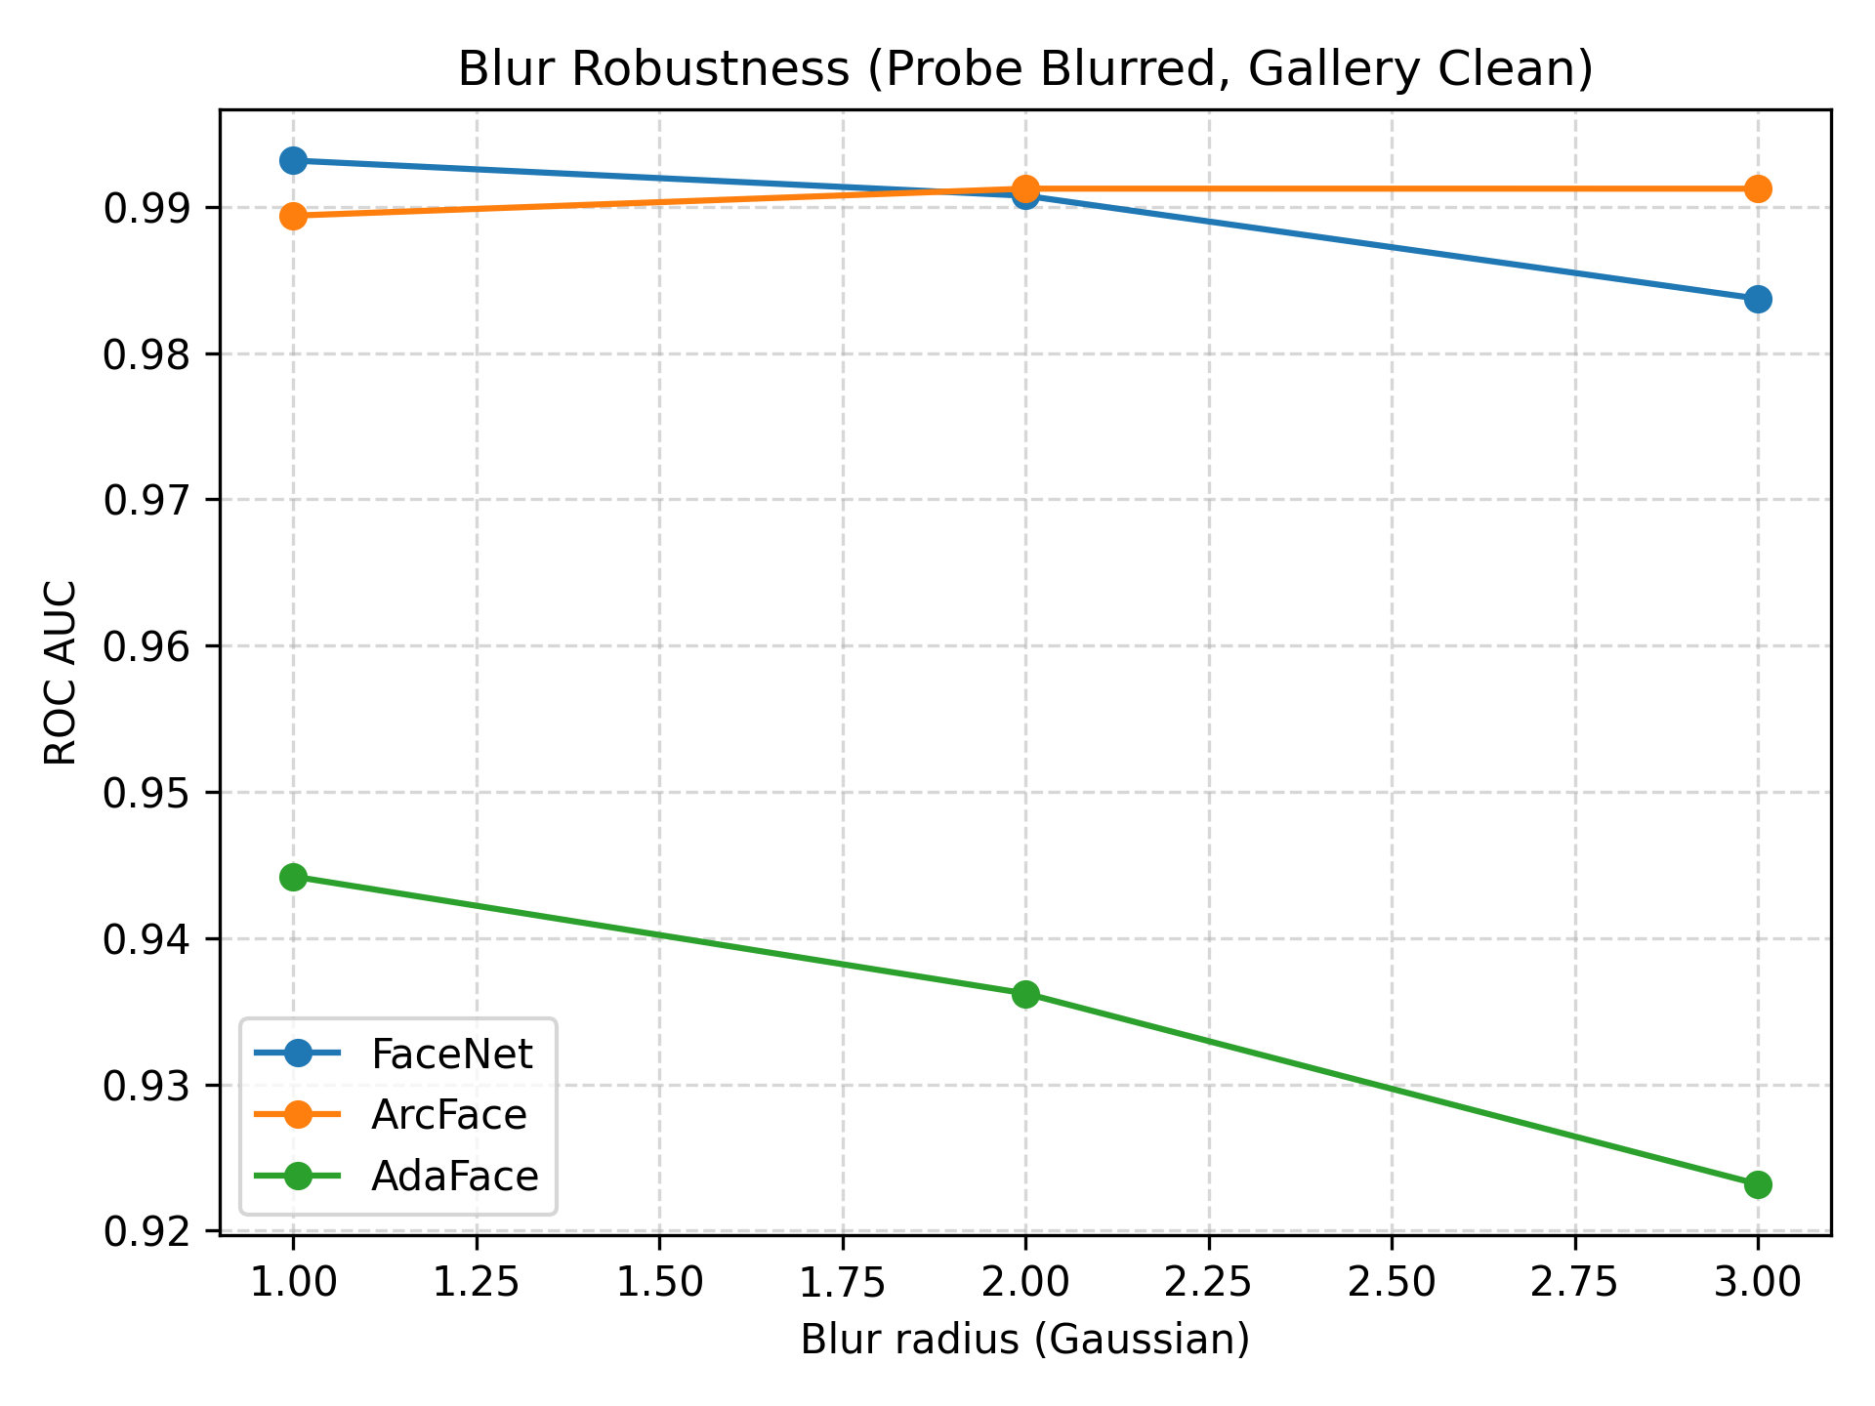
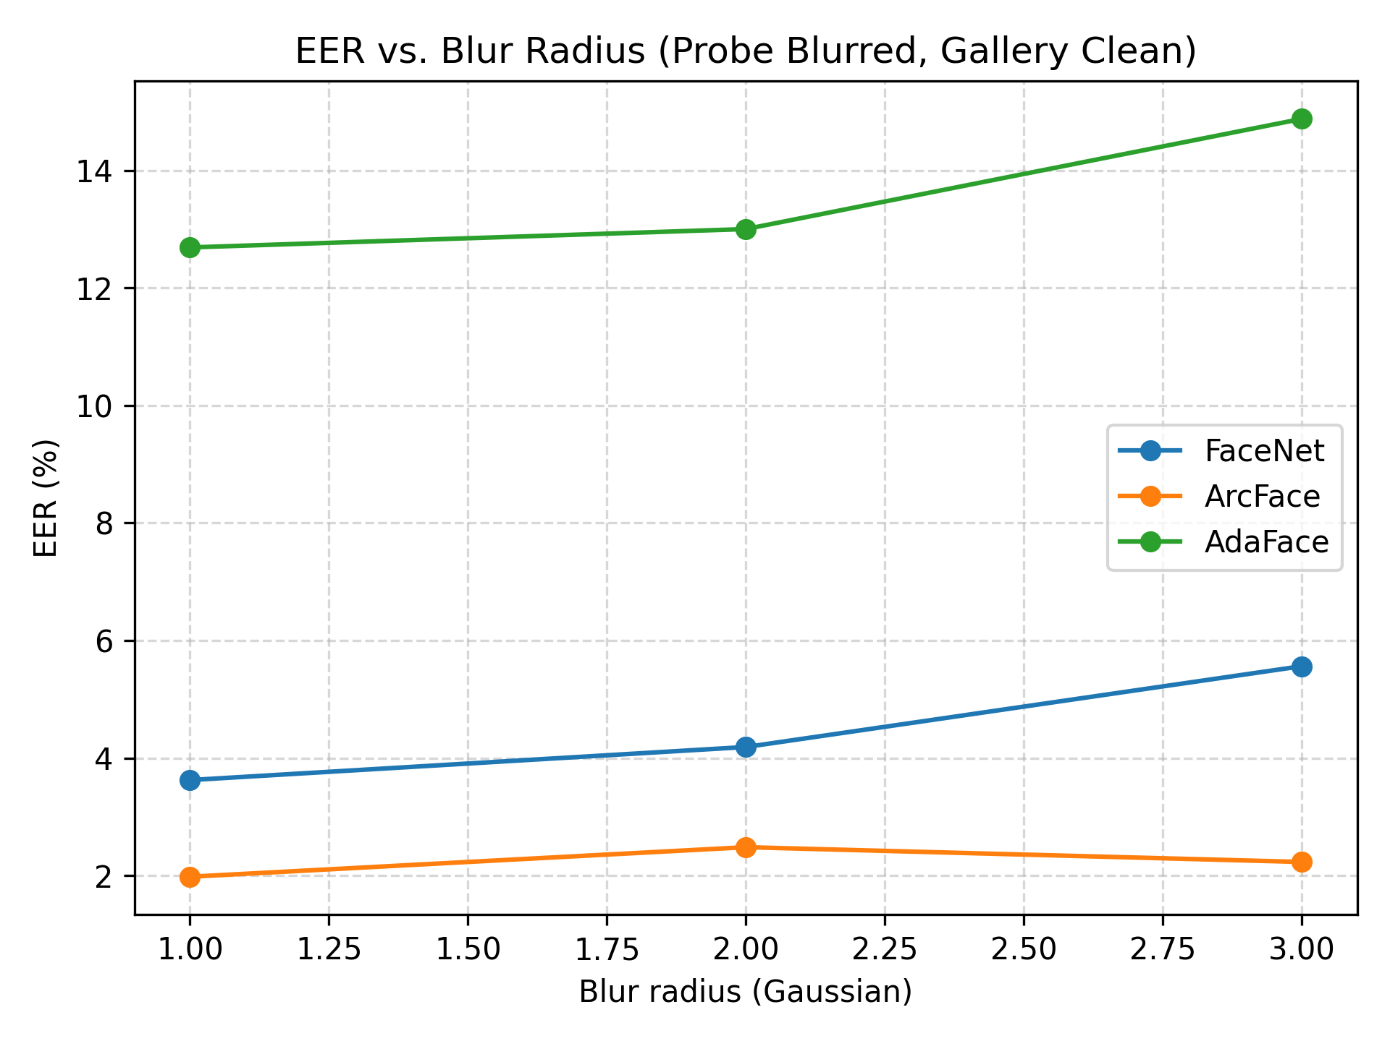
Blur Robustness
FaceNet and ArcFace degrade gracefully
Notes:
FaceNet and ArcFace degrade gracefully, AdaFace degrades more sharply, all models’ robustness drop significantly at blur r = 3

Slide 11
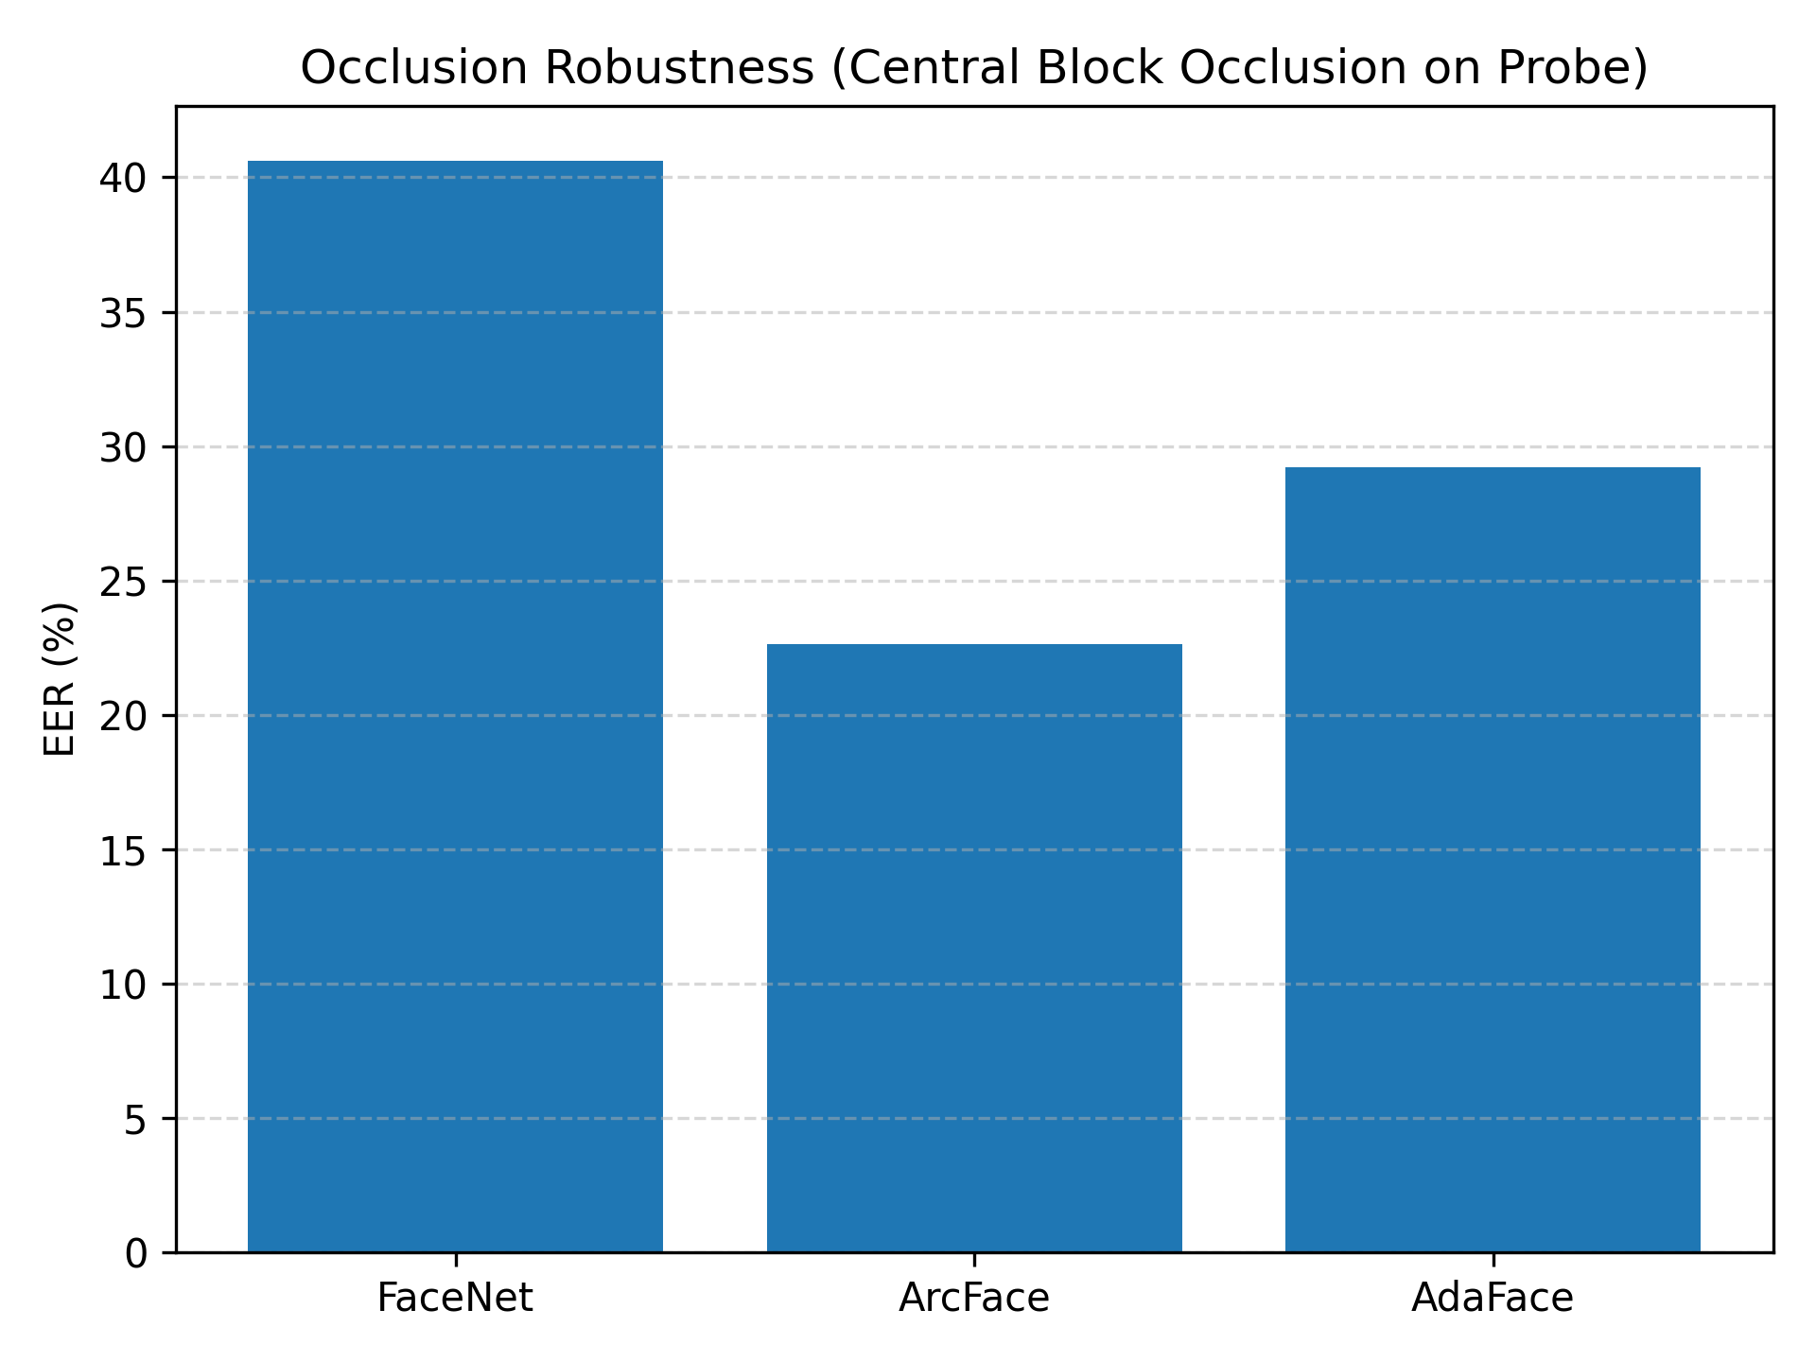
Occlusion Robustness
All models collapse under occlusion
ArcFace most robust
AdaFace least robust

Slide 12
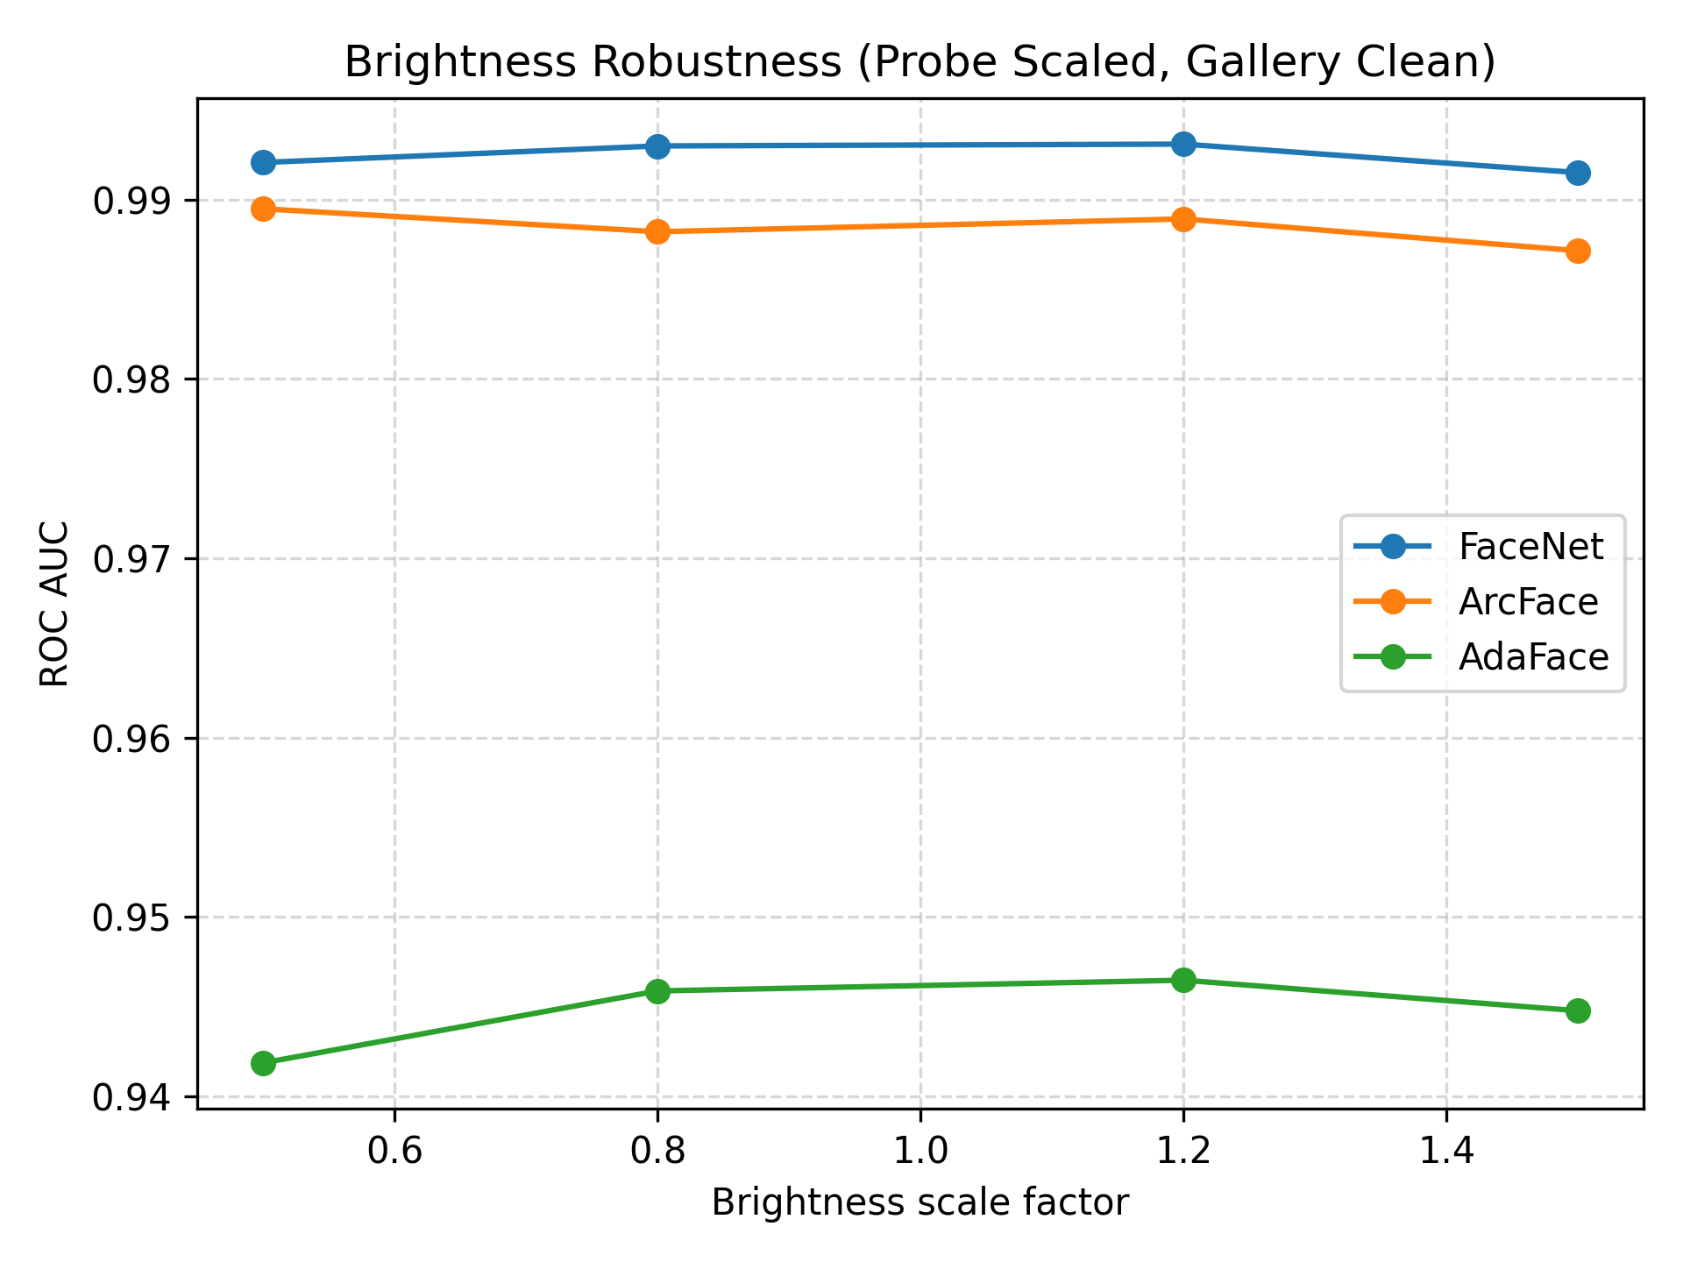
Brightness Robustness
All models resilient to brightness
ArcFace and FaceNet nearly unchanged
AdaFace converges towards baseline with mild lighting changes

Slide 13
Conclusion
FaceNet best overall stability
ArcFace best raw accuracy
AdaFace performs poorly on LFW dataset without quality metadata
All models degrade hard when testing occlusion
Loss functions & training datasets strongly affect robustness

Slide 14
Limitations
LFW dataset is small and biases (only celebrities & frontal profiles)
AdaFace expects high-quality metadata during training
Robustness tests do not cover adversarial attacks
Only cosine similarity used; no classifier heads

Slide 15
Future Work
Use more modern, larger datasets (e.g., VGGFace2, CelebA, CFP-FP, AgeDB)
Test motion blur, Gaussian noise, partial rotations, etc.
Look into adversarial abilities:
  Detecting face spoofing
  Fast Gradient Sign Method (FGSM) or Projected Gradient Descent (PGD) Attacks

Slide 16
References
[1] F. Schroff, D. Kalenichenko, and J. Philbin, “FaceNet: A unified embedding for face recognition and clustering,” Proc. IEEE Conf. Comput. Vis. Pattern Recognit. (CVPR), 2015, pp. 815–823, doi: 10.1109/CVPR.2015.7298682.
[2] J. Deng et al., “ArcFace: Additive angular margin loss for deep face recognition,” Proc. IEEE/CVF Conf. Comput. Vis. Pattern Recognit. (CVPR), 2019, pp. 4690–4699, doi: 10.1109/CVPR.2019.00482.
[3] M. Kim, A. K. Jain, and X. Liu, “AdaFace: Quality adaptive margin for face recognition,” Proc. IEEE/CVF Conf. Comput. Vis. Pattern Recognit. (CVPR), 2022, pp. 18750–18759, doi: 10.1109/CVPR52688.2022.01822.
[4] G. B. Huang, M. Ramesh, T. Berg, and E. Learned-Miller, “Labeled Faces in the Wild: A database for studying face recognition in unconstrained environments,” Univ. Massachusetts Amherst, Tech. Rep. 07-49, 2007.
[5] J. Deng et al., “RetinaFace: Single-shot multi-level face localisation in the wild,” Proc. IEEE/CVF Conf. Comput. Vis. Pattern Recognit. (CVPR), 2020, pp. 5203–5212, doi: 10.1109/CVPR42600.2020.00525.

